Slide 1
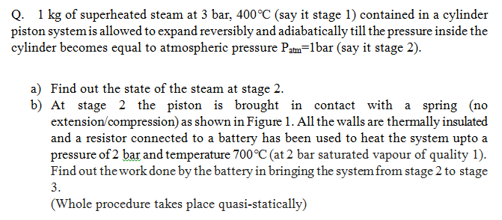
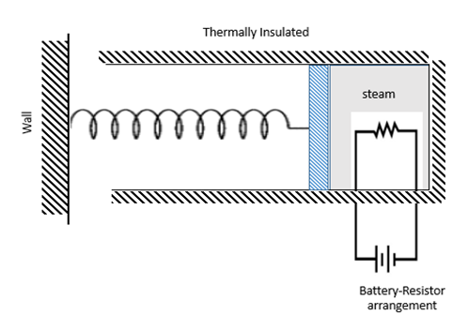

Slide 2
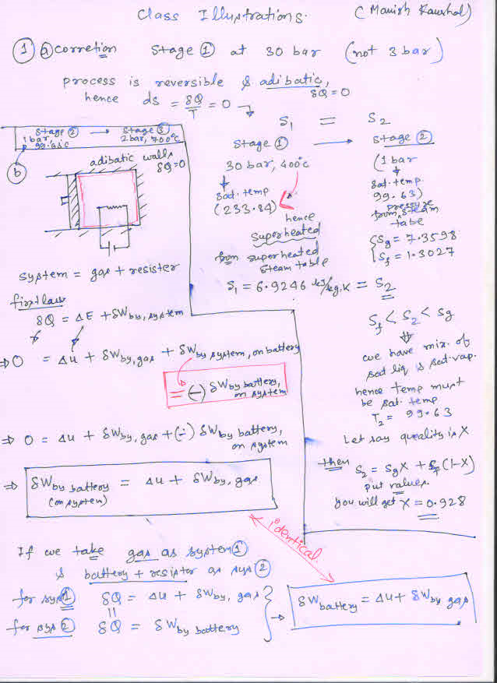

Slide 3
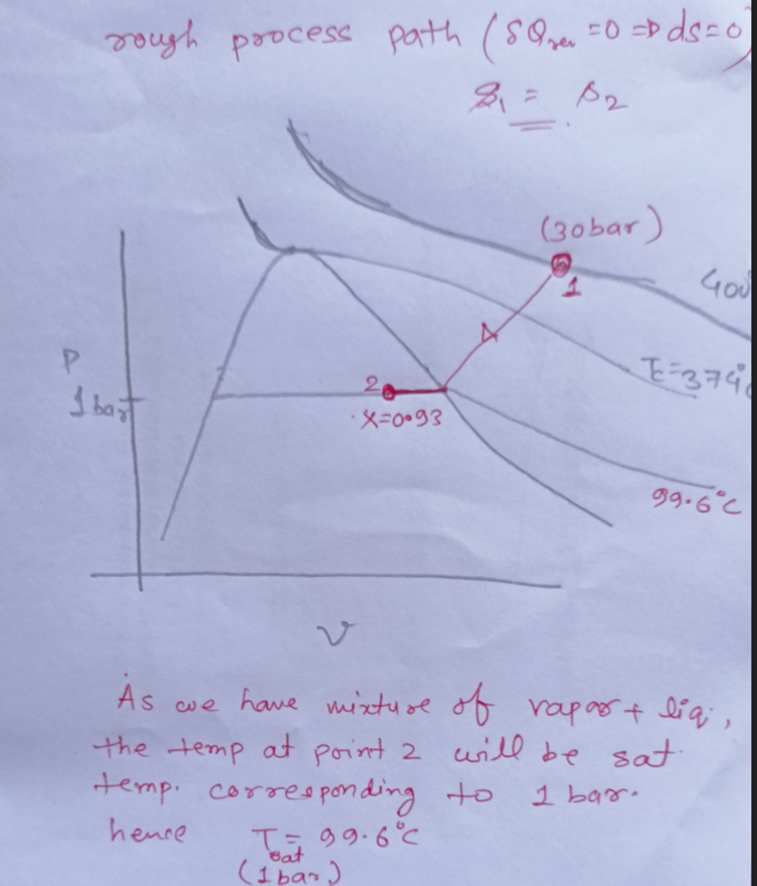
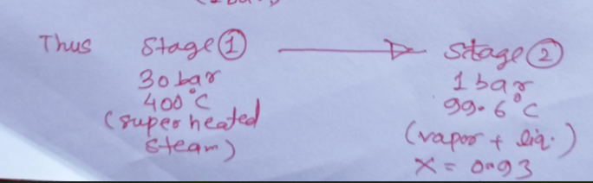

Slide 4
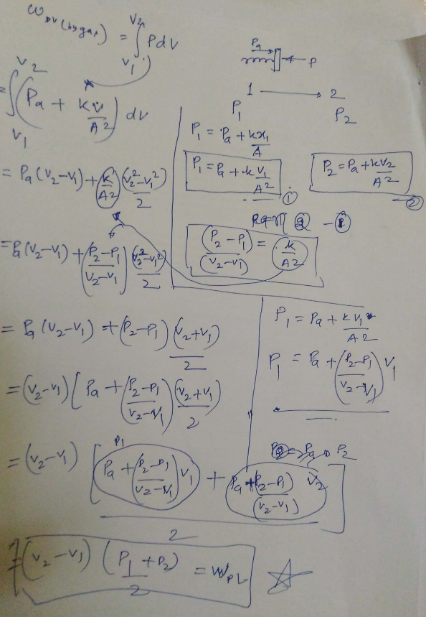

Slide 5
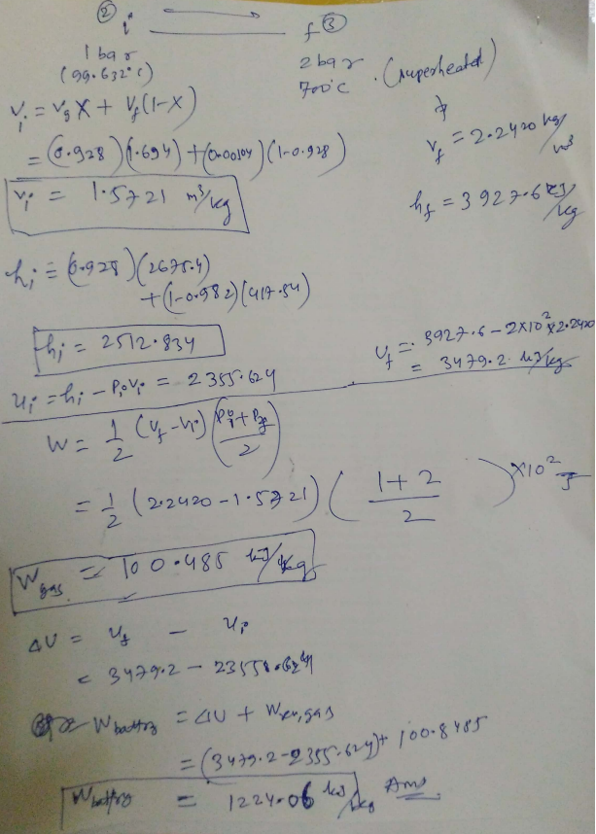

Slide 6
Class Illustration 4: 1 Kg of Steam (X=0.75) at 5 bar is contained in a piston-cylinder assembly. Heat is provided very slowly (to maintain a quasi-static process) to gas till the temperature attains a value of 200°C. During this whole process, pressure remains constant. Find out the work done by steam & heat given to steam.

Slide 7
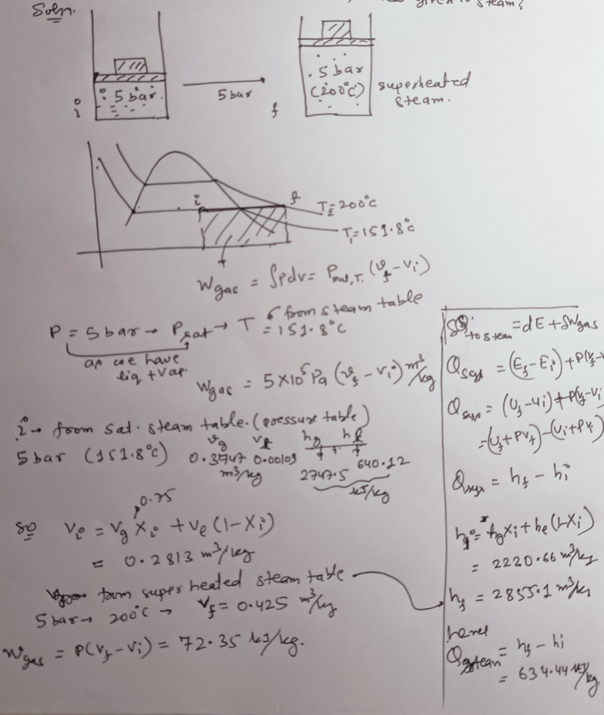

Slide 8
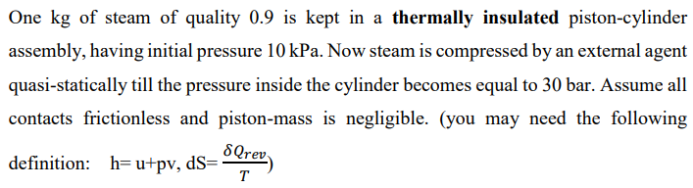


Class Illustration 5:

Slide 9
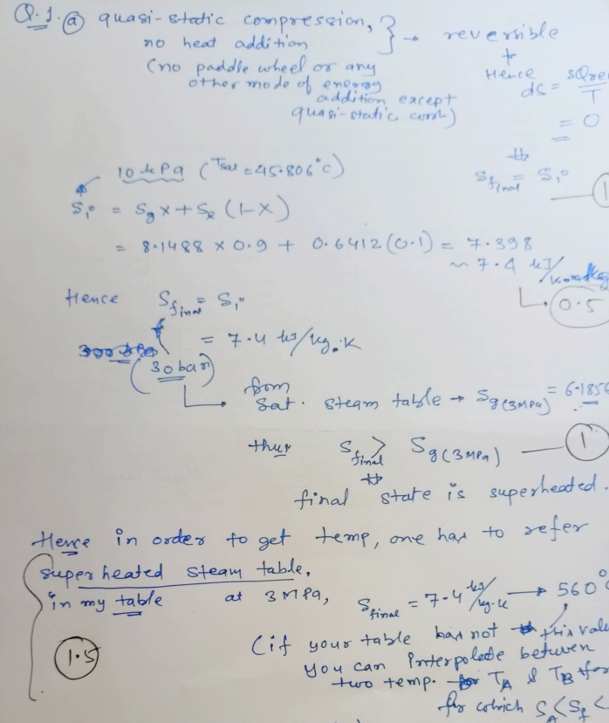

Slide 10
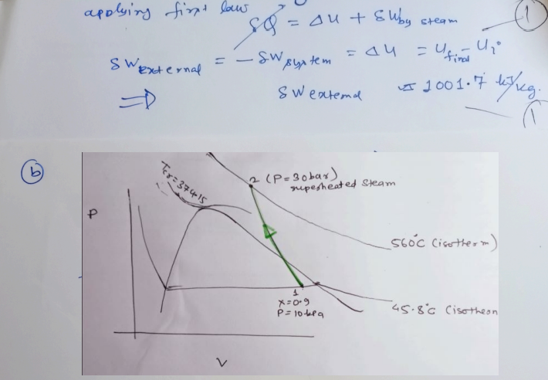

Slide 11


Reconsider the initial & final states of steam mentioned in Class illustration -5. However, this time external agent exerts a constant pressure of 30 bar on piston while compressing the steam from initial to final state.
(highlight the underlying concept)

Slide 12
